Slide 1
Introduction to Programming
Lecture 1

Slide 2

Our Team
Module Leader:
Dr. Noura El Maghawry: noura.elmaghawry@bue.edu.eg
Room: H111-D
Teaching Assistants:
Nadine Farag: Nadine.Farag@bue.edu.eg
Ayah Hesham: Ayah.hesham@bue.edu.eg
AbdelMajid Ihab: Abdelmajid.Ihab@bue.edu.eg
Amgad Abdallah: Amgad.Abdallah@bue.edu.eg
Reyam Magdy: Reyam.Magdy@bue.edu.eg
Moaz Usama: Moaz.Usama@bue.edu.eg
Office hours will be announced soon on the e-learning

Slide 3

Assessments
Coursework:
Lab Test1 –> Week 6 25%
Lab Test 2 –> Week 11 25%
Unseen Written Exam 50%

Slide 4
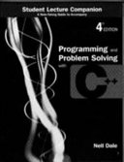
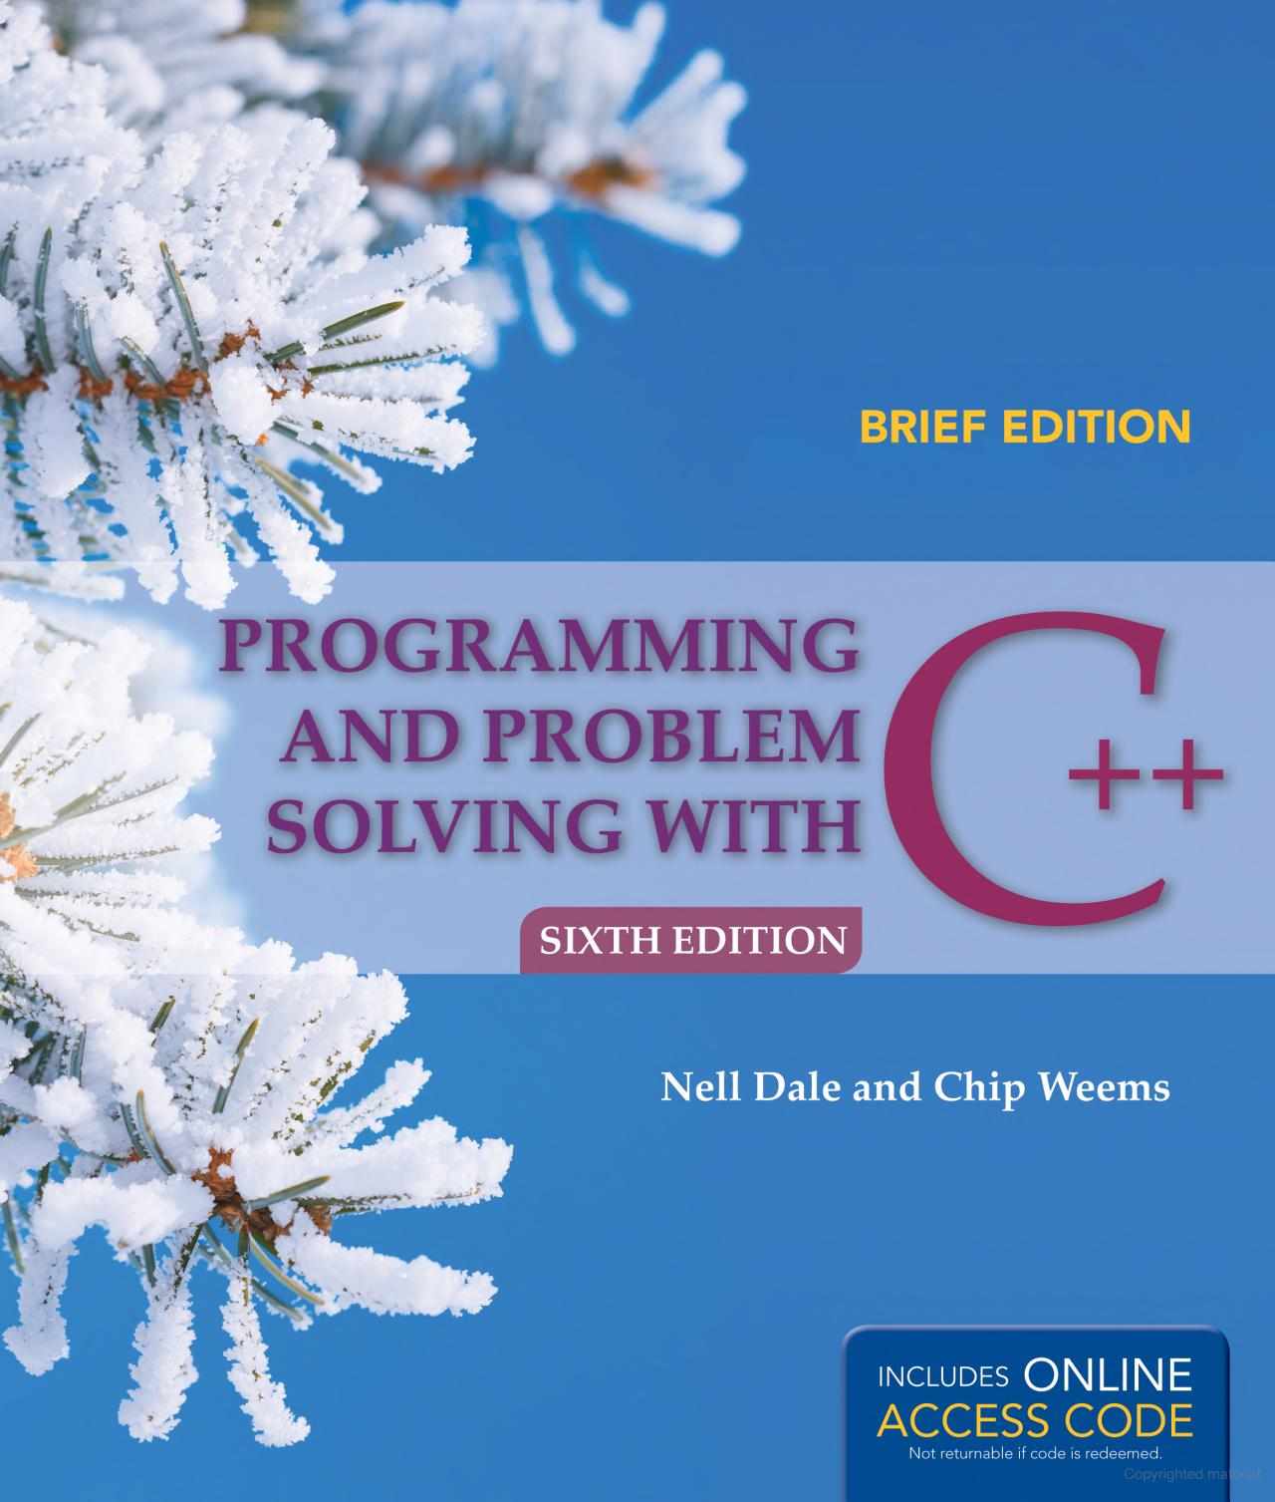
Recommended Reading List
Nell Dale, Charles C. Weems, "Programming and Problem Solving with C++, 4th Edition", Jones and Bartlett Publishers, Sudbury, MA, 2004, 1100 pp.

Slide 5


Important
“Tell me and I will forget.
Teach me and I remember.
Involve me and I learn.”
Benjamin Franklin
Always bring a neat Sheet of paper and a pencil/pen with you to the lecture.

Slide 6
Agenda
Important concepts and terminologies
Revision on Nested If statements
Switch- Case Statements.
Revision on Nested loops

Slide 7
Important concepts and terminologies

Slide 8

An Algorithm
An algorithm: is a systematic logical approach with a well-defined step-by-step procedure to solve a problem.
An algorithm is used to provide a solution to a particular problem in well-defined steps.
A problem could have more than one algorithm to solve.

Slide 9
Pseudocode
Pseudocode: It is a method which can be used to represent an algorithm in a plain English or natural language.
It does not have a specific syntax like the programming languages, thus can not be executed on the computer.
However, it has some formats to be written with that involve some programming concepts.

Slide 10
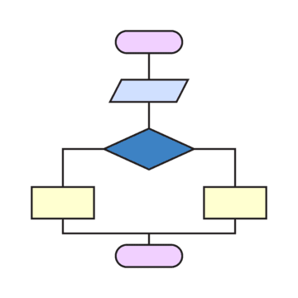
Flowcharts
Flowcharts are diagrams that use symbols and text to represent the main steps and logic of an algorithm.

Slide 11
Program
A program is a set of instructions for the computer to follow and execute.
It should be written in a specific programming language.
A program is an implementation of your algorithm.

Slide 12
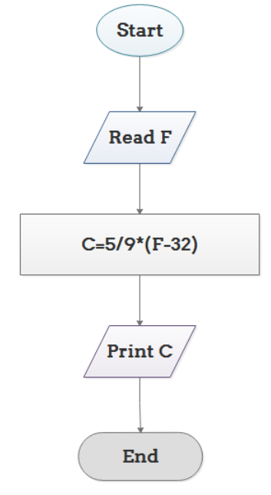
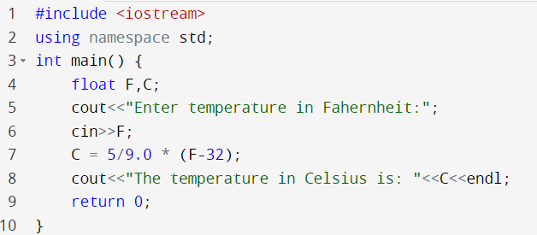
Example 1
Problem: Convert Temperature from Fahrenheit (℉) to Celsius (℃)
Flowchart:
Implementation in C++:
Algorithm written in pseudocode:
Step 1: Read temperature in Fahrenheit,
Step 2: Calculate temperature with formula
C=5/9*(F-32),
Step 3: Print C.

Slide 13
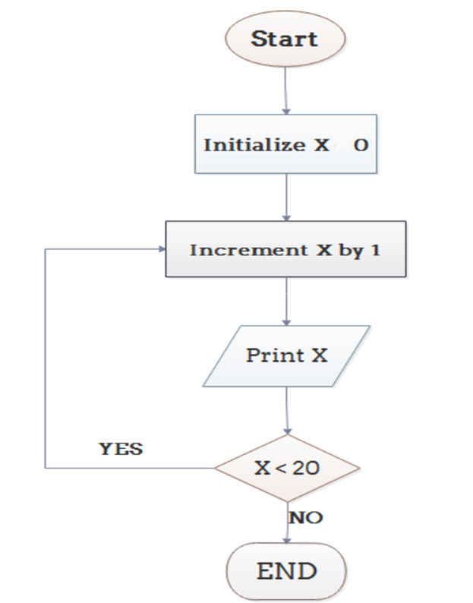
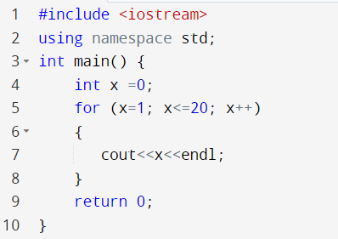
Example 2
Problem: Print from 1 to 20
Flowchart:
Implementation in C++:
Algorithm written in pseudocode:
Step 1: Initialize X as 0,
Step 2: Increment X by 1,
Step 3: Print X,
Step 4: If X is less than 20 then go back to step 2.
=

Slide 14
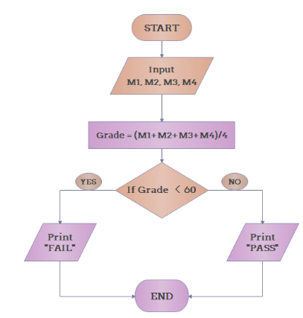
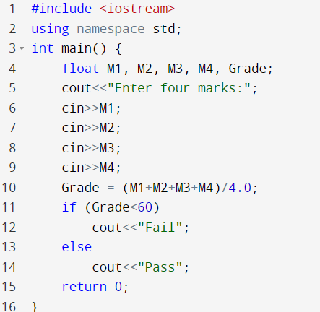
Example 3
Problem: Determine Whether A Student Passed the Exam or Not:
Flowchart:
Implementation in C++:
Algorithm written in pseudocode:
Step 1: Input grades of 4 courses M1, M2, M3 and M4,
Step 2: Calculate the average grade with formula "Grade=(M1+M2+M3+M4)/4"
Step 3: If the average grade is less than 60, print "FAIL", else print "PASS".

Slide 15
Revision on Nested If

Slide 16
Nested If: Example 1
Write a program that given a student a number grade, the program should output the letter grade for the student.
If the grade is between 70 to 100 → letter grade is A
If the grade is between 60 to 69 → letter grade is B
If the grade between 50 to 59 → letter grade is C
If the grade is between 40 to 49 → letter grade is D
If the grade is less than 40 → letter grade is F

Slide 17
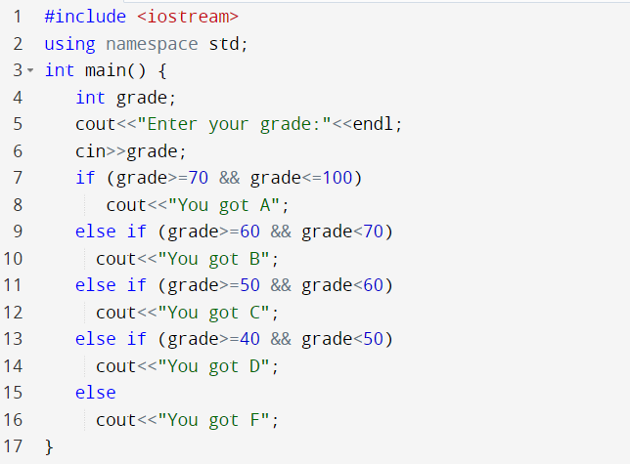


Nested If: Example 1
Compound condition

Slide 18

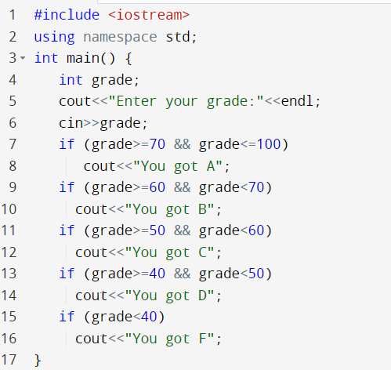
Nested If: Example 1
Which one is better?

Slide 19
Nested If: Example 2
Write a program that given a student letter grade, the program should output the range of marks.
Grade A → the grade is between 70 to 100
Grade B → the grade is between 60 to 69
Grade C → the grade is between 50 to 59
Grade D → the grade is between 40 to 49
Grade F → If the grade is less than 40

Slide 20
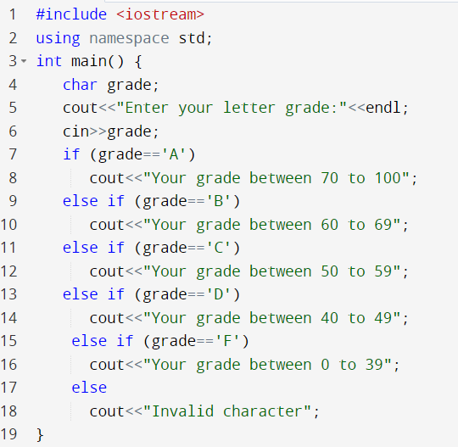
Nested if Example 2

Slide 21
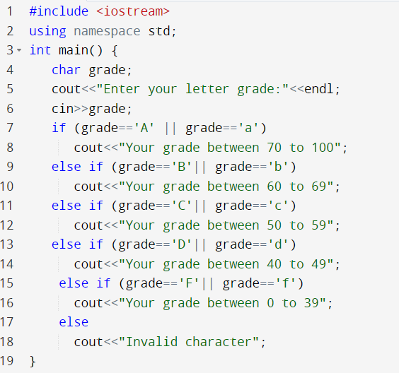
Nested if Example 2
What if you want to manage both capital and small letters?

Slide 22
Switch case statements

Slide 23
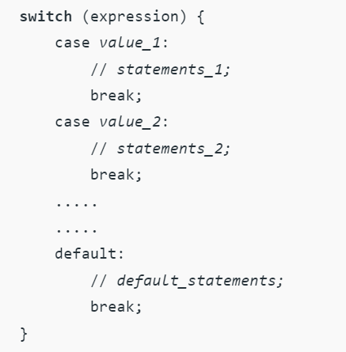

Switch case statement
The C++ Switch case statement evaluates a given expression and based on the evaluated value(matching a certain condition), it executes the statements associated with it. It is an alternative to the long if-else-if statements.
The case value can only be of type int or char

Slide 24
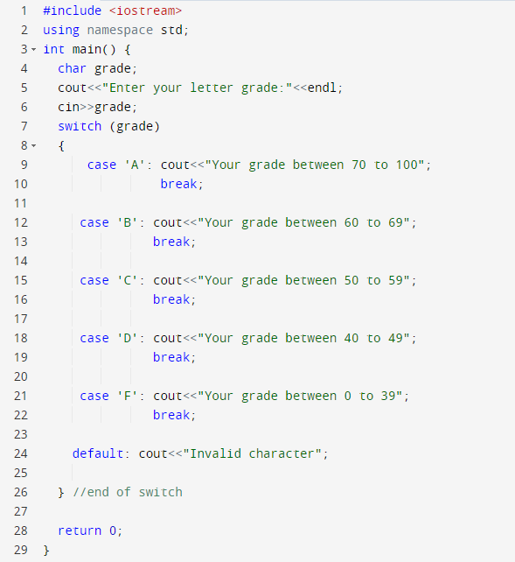
Switch case: Example 1
char

Slide 25
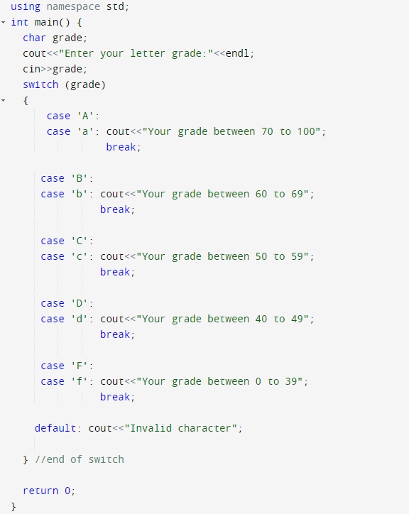
Switch case: Example 2

Slide 26
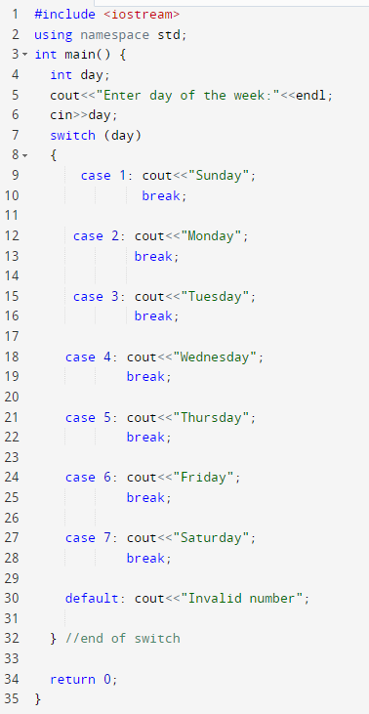
Switch case: Example 3
Write a program using switch case, given the day number, the program should output which day of the week (Sunday, Monday,..etc).
int

Slide 27

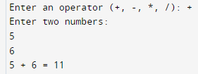
Switch case Example 4: Simple Calculator
Write a program using switch case to create a simple calculator. The user should enter a mathematical operator, then two numbers, and the program should output the result.

Slide 28
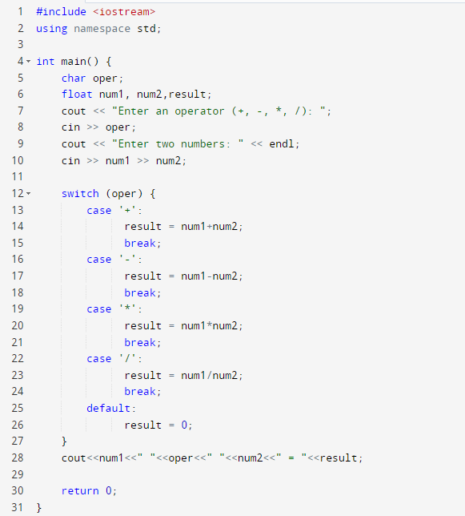

Switch case Example 4: Simple Calculator
Solution:

Slide 29
Revision on Nested loops

Slide 30
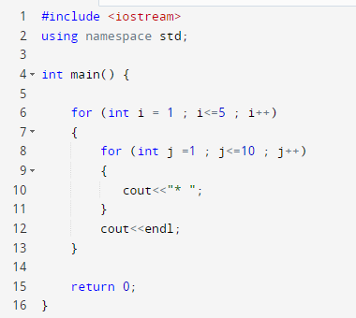
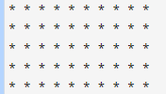
Nested Loops: Example 1
Write a program that will output 5 rows, and each row contains ten character *
output
j = 1
j = 10
i =1 →
i =5 →

Slide 31
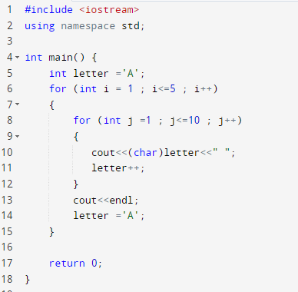
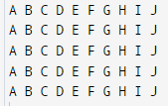
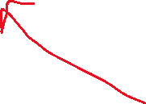
Nested Loops: Example 2
Write a program that will output 5 rows, and each row contains the first ten characters of alphabet.
output
j = 1
j = 10
i =1 →
i =5 →
Casting

Slide 32
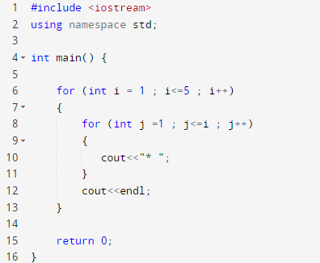

Nested Loops: Example 3
Write a program that will output the triangle shown below
output
j = 1
i =1 →
i =2 →

Slide 33

Nested Loops: Example 4
Write a program that will output the triangle shown below
output

Slide 34
Nested loops to be continued next Lecture + new content.

Slide 35
Resources
Some flowchart diagrams are taken from:
https://www.edrawsoft.com/explain-algorithm-flowchart.html

Slide 36

Thank You

